Slide 1
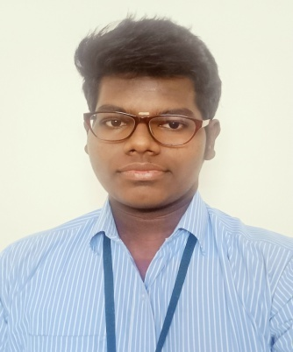


D. MADHAN RAJ
Mobile : 9360770284 E-mail : madhanraj242003@gmail.com
Address:
# 6, Abboy Street, B.O.D. Road,
Chathiram, Pattabiram, Chennai – 600 072. (Near Sub-Post Office)
Objective
I
Seeking a challenging position in a competitive environment to utilize my skills and abilities and to satisfy the expectation of the organization.
Academic Details
2023 : Pursuing in B.E. (Computer Engineering) IV Semester at Vellammal Engineering College, Chennai-66
2022 : Diploma in Computer Engineering (DCE) Murugappa Polytechnic College, Chennai-62.
Percentage : 80%
2019 : S.S.L.C.
Jaya Matriculation Hr. Sec. School, Thiruninravur-602 024.
Percentage : 68%
Technical Skills
Application Software : MS-OFFICE, PHOTOSHOP
Programming Language : C, C++, JAVA
Web Development : HTML, CSS, JAVASCRIPT
Editing Software : WONDERSHARE FILMORA
Achievement & Certification
  Certificate of Appreciation for Online Quiz on CORE JAVA PROGRAMMING organized by Murugappa Polytechnic.
  Certification of Participation through online in Training on Cyber Crime Awarness by COLLCOM, New Delhi on 2020.
  Life Skills Training conducted by GTT Foundation.
Notes:
Designed by Showeet.com

Slide 2
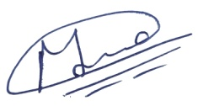
Current Organizatiotlec Plant 3
Duration : From Jan 2020 to Till date
Designation : CNC Operator
Job Nature : Managing Bearing manufacture
Strength
  Hardworking  Efficient Work
  Team Work  Co-ordination
Areas of Interest
Video & Photo Editing
Content Creating
Web Designing
Personal Details
Name : D. MADHAN RAJ
Father’s Name : Mr. R. DAMODARAN
Date of Birth : 24.09.2003
Marital Status : Single
Gender : Male
Nationality : Indian
Religion : Hindu
Languages Known : English & Tamil
Address : No. 6, Abboy Street, B.O.D. Road,
Chathiram, Pattabiram, Chennai-72.
Contact : 9360770284
Declaration
I hereby delcare that the information provided above is correct to the best of
my knowledge.
Yours Sincerely,
Place : Pattabiram, Chennai-72
Date : [D. Madhan Raj]
Notes:
Designed by Showeet.com

